Slide 1

Excited States, Variational Principles,
and Quantum Monte Carlo
Eric Neuscamman
YOU HAVE 35+5 mins to speak!!!
June 13, 2018

Slide 2
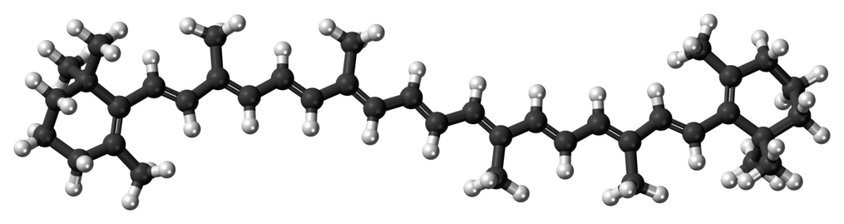
motivation
charge transfer
core spectroscopy
double excitations

Slide 3



the menu
aperitif: fun with QMC
main course: excited states with QMC
dessert: mean field theory

Slide 4
real-space Gutzwiller
RHF
energy +12 (Hartrees)
MRCI+Q
C-C distance (Angstroms)
Van Der Goetz & Neuscamman, JCTC 2017
Van Der Goetz & Neuscamman, unpublished

Slide 5
real-space Gutzwiller
RHF
energy +12 (Hartrees)
+Jastrows
MRCI+Q
C-C distance (Angstroms)
Van Der Goetz & Neuscamman, JCTC 2017
Van Der Goetz & Neuscamman, unpublished

Slide 6
real-space Gutzwiller
RHF
energy +12 (Hartrees)
+Jastrows
MRCI+Q
+DMC
C-C distance (Angstroms)
Van Der Goetz & Neuscamman, JCTC 2017
Van Der Goetz & Neuscamman, unpublished

Slide 7
the menu
aperitif: fun with QMC
main course: excited states with QMC
dessert: mean field theory

Slide 8
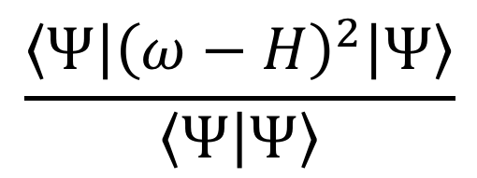

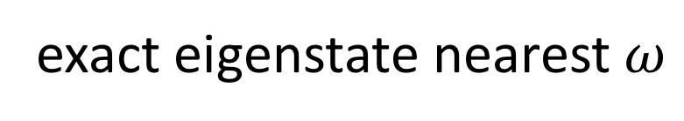

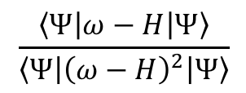
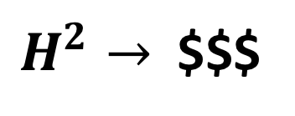
excited state variational principles
energy not stationary
size consistency
challenges
not unique
$$\frac{\left\langle Ψ | {\left(ω−H\right)}^{2} | Ψ\right\rangle }{\left\langle Ψ | Ψ\right\rangle }$$
$H^{2}→$$$$
$$\frac{\left\langle Ψ | ω−H | Ψ\right\rangle }{\left\langle Ψ | {\left(ω−H\right)}^{2} | Ψ\right\rangle }$$
global minimum:
$${\left(ω−E\right)}^{2}+2σ^{2}$$
exact eigenstate nearest $ω$
$$⋮$$
Choi, Lebeda, Messmer, CPL 1970
Van Voorhis et al, JCP 2017

Slide 9
excited state variational principles
energy not stationary
size consistency
challenges
not unique
$$\frac{\left\langle Ψ | {\left(ω−H\right)}^{2} | Ψ\right\rangle }{\left\langle Ψ | Ψ\right\rangle }$$
$H^{2}→$$$$
$$\frac{\left\langle Ψ | ω−H | Ψ\right\rangle }{\left\langle Ψ | {\left(ω−H\right)}^{2} | Ψ\right\rangle }$$
global minimum:
$${\left(ω−E\right)}^{2}+2σ^{2}$$
exact eigenstate nearest $ω$
$$⋮$$
Zhao & Neuscamman, arXiv 1804.09663
Shea & Neuscamman, JCTC 2017
Choi, Lebeda, Messmer, CPL 1970
QMC
Blunt & Neuscamman, JCP 2017
Van Voorhis et al, JCP 2017
Robinson, Flores, Neuscamman, JCP 2017
Neuscamman, JCP 2016
Zhao & Neuscamman, JCTC 2016, 2017

Slide 10
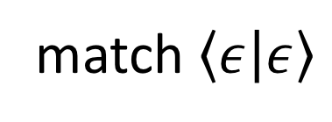
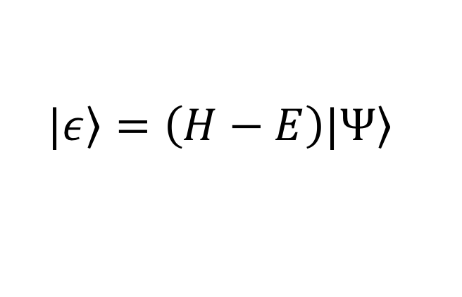
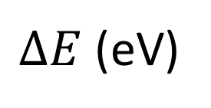
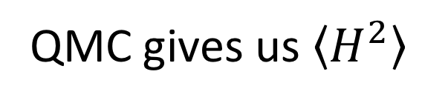
fairness in thioformaldehyde
$$|\left.ε\right\rangle =\left(H−E\right)|\left.Ψ\right\rangle$$
H
:
match $\left\langle ε | ε\right\rangle$
C
S
QMC gives us $\left\langle H^{2}\right\rangle$
H
:
+ Jastrow + state-specific orb. opt.
excited state
VMC
unconverged
CIPSI+PT2
EOM-CCSD
cc-pVDZ
exp.
cc-pVTZ
aug-cc-pVTZ
2.0
2.1
2.2
2.3
2.4
CASPT2/MRCI
$ΔE$ (eV)
Judge & King, Can J Phys 1975
Pineda Flores & Neuscamman, in preparation

Slide 11
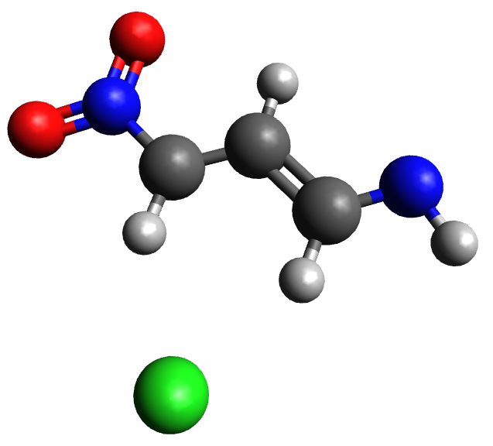
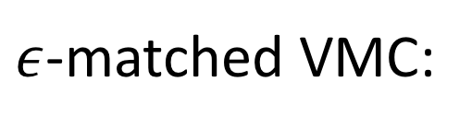
?#$%!?^*#?@ in cc-pVDZ
$ε$-matched VMC:
3.8 eV
state-averaged CASSCF:
2.7 eV to 5.9 eV (yikes!)
state-specific CASSCF:
[ ]⁻
4.4 eV
state-specific CASPT2:
3.5 eV
Pineda Flores & Neuscamman, in preparation

Slide 12
optical gaps
LiF
VMC gap (eV)
C
LiH
ZnO
Si
Experimental gap (eV)
Zhao & Neuscamman, arXiv 1804.09663

Slide 13

Zinc Oxide
G₀W₀ HF
Experiment
BSE exciton binding $\sim 0.06$ eV
Gap (eV)
G₀W₀ PBE0
G₀W₀ HSE
G₀W₀ PBE
Bechstedt et al, PRB 2009
Pulci et al, PRB 2010
Kresse et al, PRB 2007 (2 papers)
Zhao & Neuscamman, arXiv 1804.09663

Slide 14
Zinc Oxide
G₀W₀ HF
Experiment
BSE exciton binding $\sim 0.06$ eV
Gap (eV)
GW HSE
G₀W₀ PBE0
GW PBE
G₀W₀ HSE
G₀W₀ PBE
Bechstedt et al, PRB 2009
Pulci et al, PRB 2010
Kresse et al, PRB 2007 (2 papers)
Zhao & Neuscamman, arXiv 1804.09663

Slide 15


Zinc Oxide
G₀W₀ HF
VMC-LDA
64% HOMO $→$ LUMO
VMC-PBE0
16% HOMO-1$→$ LUMO
85% HOMO $→$ LUMO
VMC LDA
3% HOMO-2 $→$ LUMO
VMC PBE0
Experiment
BSE exciton binding $\sim 0.06$ eV
Gap (eV)
GW HSE
G₀W₀ PBE0
GW PBE
VMC-LDA for LiF
G₀W₀ HSE
47% HOMO $→$ LUMO
36% HOMO-1$→$ LUMO
G₀W₀ PBE
Bechstedt et al, PRB 2009
Pulci et al, PRB 2010
Kresse et al, PRB 2007 (2 papers)
Zhao & Neuscamman, arXiv 1804.09663

Slide 16
the menu
aperitif: fun with QMC
main course: excited states with QMC
dessert: mean field theory

Slide 17
the quantum chemistry cookbook
FCI-QMC
Hartree
Fock
MP2
CCSD
ground state mean field theory

Slide 18
the quantum chemistry cookbook
varational principle
Hartree
minimally correlated ansatz
Fock
stationary energy
size consistent
Fock-build cost
orbitals consistent with their own mean field

Slide 19
ingredients
varational principle
Hartree
minimally correlated ansatz
Fock
Lagrangian
stationary energy
size consistent
Fock-build cost
orbitals consistent with their own mean field

Slide 20
pie in the sky
varational
minimally
principle
correlated ansatz
MP2
CCSD
Lagrangian
a mean field platform for ground excited states
Shea & Neuscamman, arXiv 1806.00853

Slide 21


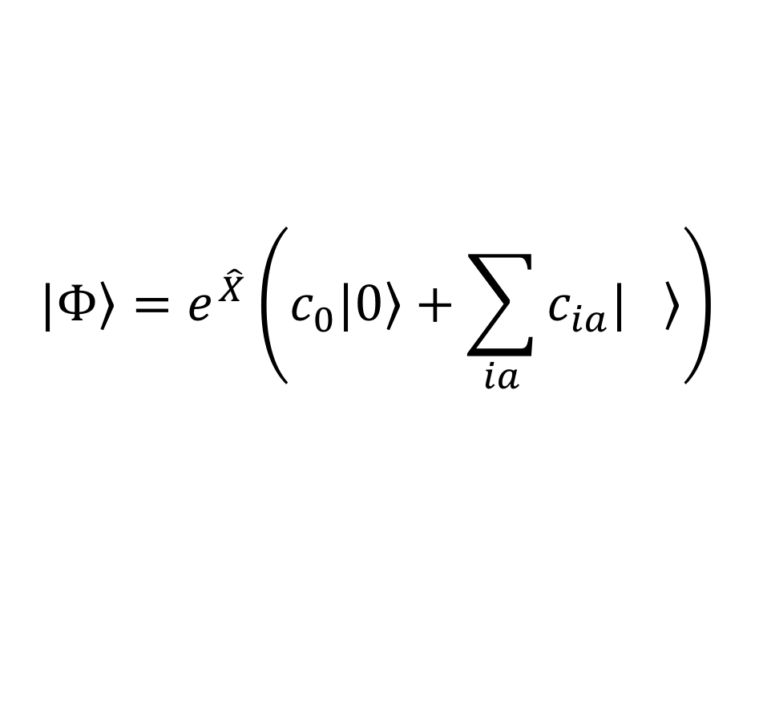
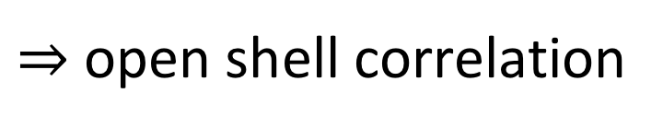
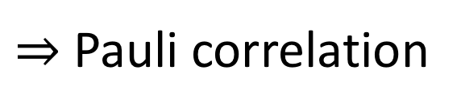

the ansatz
mean-field: minimal correlation, relaxed orbitals
$⇒$Pauli correlation
$⇒$open shell correlation
$$|\left.Φ\right\rangle =e^{\hat{X}}\left(c_{0}|\left.0\right\rangle +\sum_{ia}{c_{ia}|\left. \right\rangle }\right)$$
$$a$$
$$i$$
strong correlation $→$ CASSCF
Shea & Neuscamman, arXiv 1806.00853

Slide 22
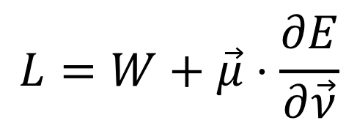
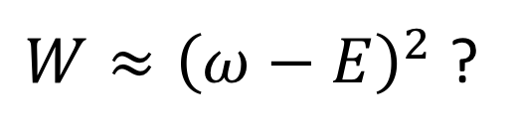
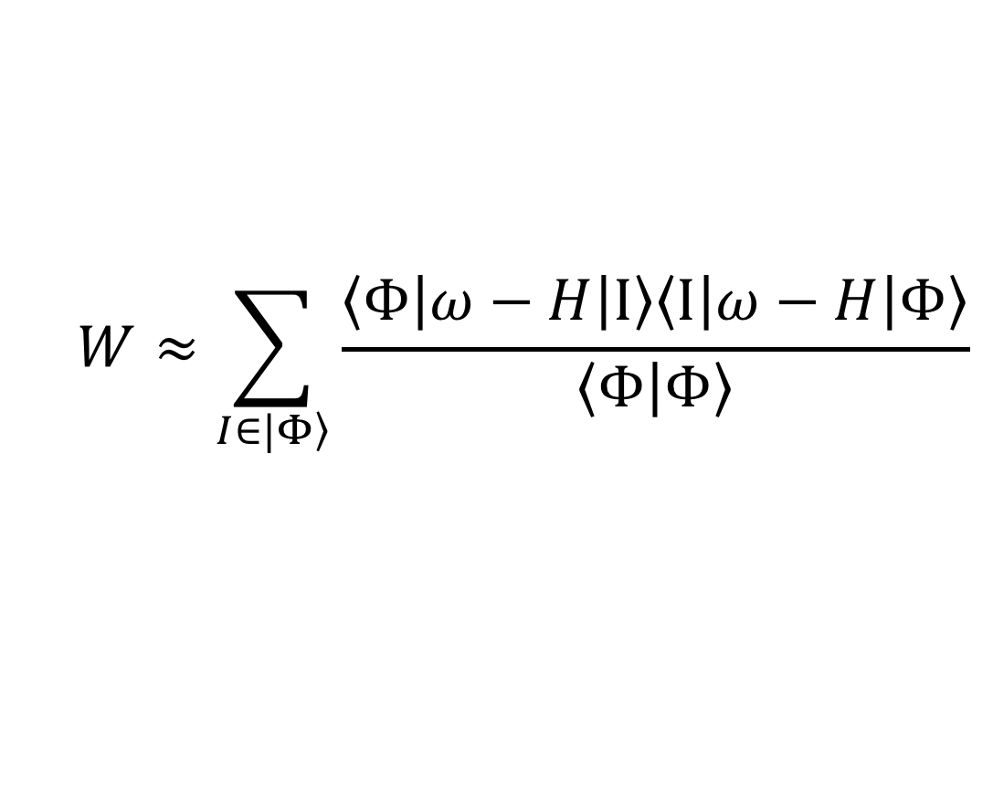
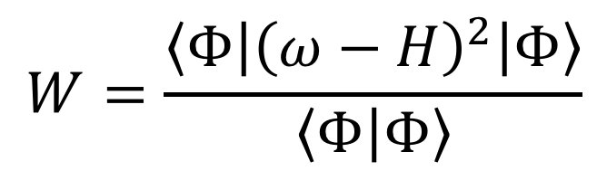
behavioral economics
$$L=W+\vec{μ}⋅\frac{∂E}{∂\vec{ν}}$$
$$W=\frac{\left\langle Φ | {\left(ω−H\right)}^{2} | Φ\right\rangle }{\left\langle Φ | Φ\right\rangle }$$
selects state
guarantees stationary energy
$$W≈\sum_{I∈|\left.Φ\right\rangle }{\frac{\left\langle Φ | ω−H | I\right\rangle \left\langle I | ω−H | Φ\right\rangle }{\left\langle Φ | Φ\right\rangle }}$$
$W≈{\left(ω−E\right)}^{2}$ ?
Shea & Neuscamman, arXiv 1806.00853

Slide 23






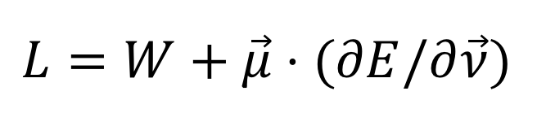
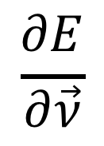
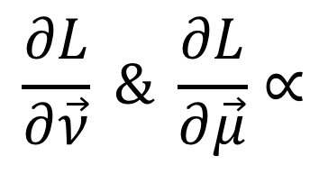
automatic differentiation
$$L=W+\vec{μ}⋅(∂E/∂\vec{ν})$$
$$\frac{∂E}{∂\vec{ν}}$$
$$E$$
$$\vec{ν}$$
TensorFlow
repeat one more time…
$$L$$
$$+$$
dot product
$$\frac{∂L}{∂\vec{ν}} \& \frac{∂L}{∂\vec{μ}}∝$$
$$\vec{μ}$$
Fock build cost
$$W$$
Shea & Neuscamman, arXiv 1806.00853

Slide 24





water singlet excitations, cc-pVDZ
$$n→σ^{∗}$$
$$n→π^{∗}$$
$$σ→σ^{∗}$$
$$σ→π^{∗}$$
$$π→σ^{∗}$$
CIS
error vs EOM-CCSD (eV)
Shea & Neuscamman, arXiv 1806.00853

Slide 25
water singlet excitations, cc-pVDZ
$$n→σ^{∗}$$
$$n→π^{∗}$$
$$σ→σ^{∗}$$
$$σ→π^{∗}$$
$$π→σ^{∗}$$
CIS
error vs EOM-CCSD (eV)
ESMF
Shea & Neuscamman, arXiv 1806.00853

Slide 26
water singlet excitations, cc-pVDZ
$$n→σ^{∗}$$
$$n→π^{∗}$$
$$σ→σ^{∗}$$
$$σ→π^{∗}$$
$$π→σ^{∗}$$
CIS
error vs EOM-CCSD (eV)
ESMF
CIS(D)
Shea & Neuscamman, arXiv 1806.00853

Slide 27
water singlet excitations, cc-pVDZ
$$n→σ^{∗}$$
$$n→π^{∗}$$
$$σ→σ^{∗}$$
$$σ→π^{∗}$$
$$π→σ^{∗}$$
ESMP2
CIS
error vs EOM-CCSD (eV)
ESMF
CIS(D)
Shea & Neuscamman, arXiv 1806.00853

Slide 28



CH₂O singlet excitations, cc-pVDZ
$$n→π^{∗}$$
$$π→π^{∗}$$
$$n→σ^{∗}$$
CIS
error vs EOM-CCSD (eV)
Shea & Neuscamman, arXiv 1806.00853

Slide 29
CH₂O singlet excitations, cc-pVDZ
$$n→π^{∗}$$
$$π→π^{∗}$$
$$n→σ^{∗}$$
CIS
error vs EOM-CCSD (eV)
ESMF
Shea & Neuscamman, arXiv 1806.00853

Slide 30
CH₂O singlet excitations, cc-pVDZ
$$n→π^{∗}$$
$$π→π^{∗}$$
$$n→σ^{∗}$$
CIS
CIS(D)
error vs EOM-CCSD (eV)
ESMF
Shea & Neuscamman, arXiv 1806.00853

Slide 31
CH₂O singlet excitations, cc-pVDZ
$$n→π^{∗}$$
$$π→π^{∗}$$
$$n→σ^{∗}$$
CIS
CIS(D)
error vs EOM-CCSD (eV)
ESMP2
ESMF
Shea & Neuscamman, arXiv 1806.00853

Slide 32
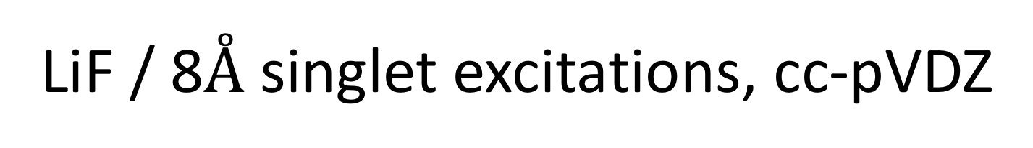



LiF / 8$Å$ singlet excitations, cc-pVDZ
$$F 2p_{x}→Li 2s$$
$$F 2p_{z}→Li 2s$$
$$F 2p_{z}→Li 2p_{z}$$
CIS
error vs EOM-CCSD (eV)
Shea & Neuscamman, arXiv 1806.00853

Slide 33
LiF / 8$Å$ singlet excitations, cc-pVDZ
$$F 2p_{x}→Li 2s$$
$$F 2p_{z}→Li 2s$$
$$F 2p_{z}→Li 2p_{z}$$
CIS
error vs EOM-CCSD (eV)
ESMF
Shea & Neuscamman, arXiv 1806.00853

Slide 34
LiF / 8$Å$ singlet excitations, cc-pVDZ
$$F 2p_{x}→Li 2s$$
$$F 2p_{z}→Li 2s$$
$$F 2p_{z}→Li 2p_{z}$$
CIS
error vs EOM-CCSD (eV)
CIS(D)
ESMF
Shea & Neuscamman, arXiv 1806.00853

Slide 35
LiF / 8$Å$ singlet excitations, cc-pVDZ
$$F 2p_{x}→Li 2s$$
$$F 2p_{z}→Li 2s$$
$$F 2p_{z}→Li 2p_{z}$$
CIS
ESMP2
error vs EOM-CCSD (eV)
CIS(D)
ESMF
Shea & Neuscamman, arXiv 1806.00853

Slide 36
LiF / 8$Å$ singlet excitations, cc-pVDZ
$$F 2p_{x}→Li 2s$$
$$F 2p_{z}→Li 2s$$
$$F 2p_{z}→Li 2p_{z}$$
CIS
ESMP2
error vs EOM-CCSD (eV)
within 0.1eV of MRCI+Q
CIS(D)
ESMF
Shea & Neuscamman, arXiv 1806.00853

Slide 37
comparison to EOM(2,3)
EOM-CCSD
CIS(D)
ESMP2
mean unsigned error (eV)
0.52
0.11
0.06
max unsigned error (eV)
1.48
0.22
0.10

Slide 38
future directions
Monte Carlo
mean field theory
oo-MSJ in solids
DIIS, NR, etc.
core & CT excitations
production code
generalized backflow
CC theory
better optimizers
CASSCF
vectorization
sCI & DMRG
is there a Kohn-Sham analogue hiding nearby?

Slide 39

acknowledgements
- Gas Phase Chemical Physics
- Early Career Research Program

